Slide 1

Background
Mike Goodman, the head of Product Management of a retail products company, is responsible for determining which products his company should continue to offer for sale and which products should be discontinued from the company’s product catalog.
Objective
To build a dashboard that will present monthly sales performance by product segment and product category to help client identifying the segments and categories that have met or exceeded their sales targets, as well as those that have not met their sales targets.
Domain: Ecommerce
Source Link:
https://public.tableau.com/views/SalesPerformanceAnalysis_16440472130660/Dashboard?:language=de-DE&:display_count=n&:origin=viz_share_link

Slide 2
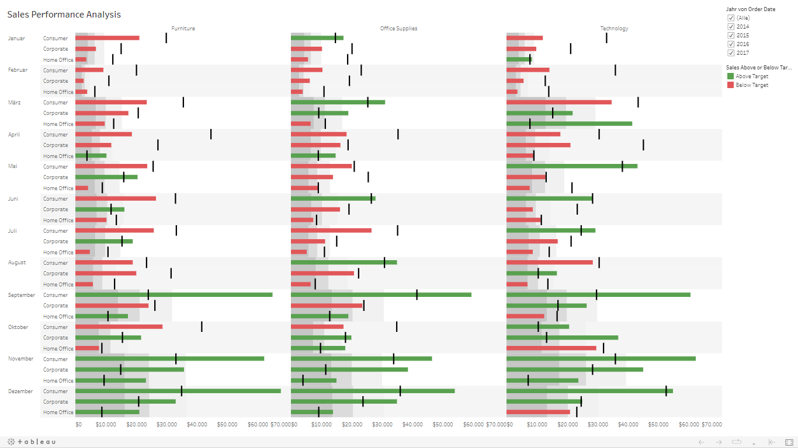
Insert the screenshot/snipped end result of Project

Slide 3
Project Description ( Min 5 points - about what you understood from visualizing data)
Considering all data entries regarding years 2014-2017, it can be appreciated that the last trimester in the year represented by months September, October, November and December is the one that registered the highest amount of sales
November is the only month where target sales were met for both consumer, corporate and home office categories, followed by December ´s second best result with just 1 unaccomplished target sale in Home Office Category for Technology
During February, sales plummeted, and none of the sales were met for any category
My advise to Mike Goodman, the head of Product Management if some products had to be discontinued, would be to remove Office Supplies products, since this category presented the least amount of overall sales, with 719 k dollars. Consumer segment achieved the higher sales peaks , whereas corporate and home office are the weakest segments among this category
The Technology category achieved the highest sales, with a value of 836 k dollars, with once again the higher peaks in the consumer segment. This is the area where the company should focus in order to maintain its competitive advantage and its value offered to the company´s customers.

